Slide 1


The evolution of environmental law in France.
Ana Candau,
Chiara Martinelli,
Anthonin Minier.

Slide 2
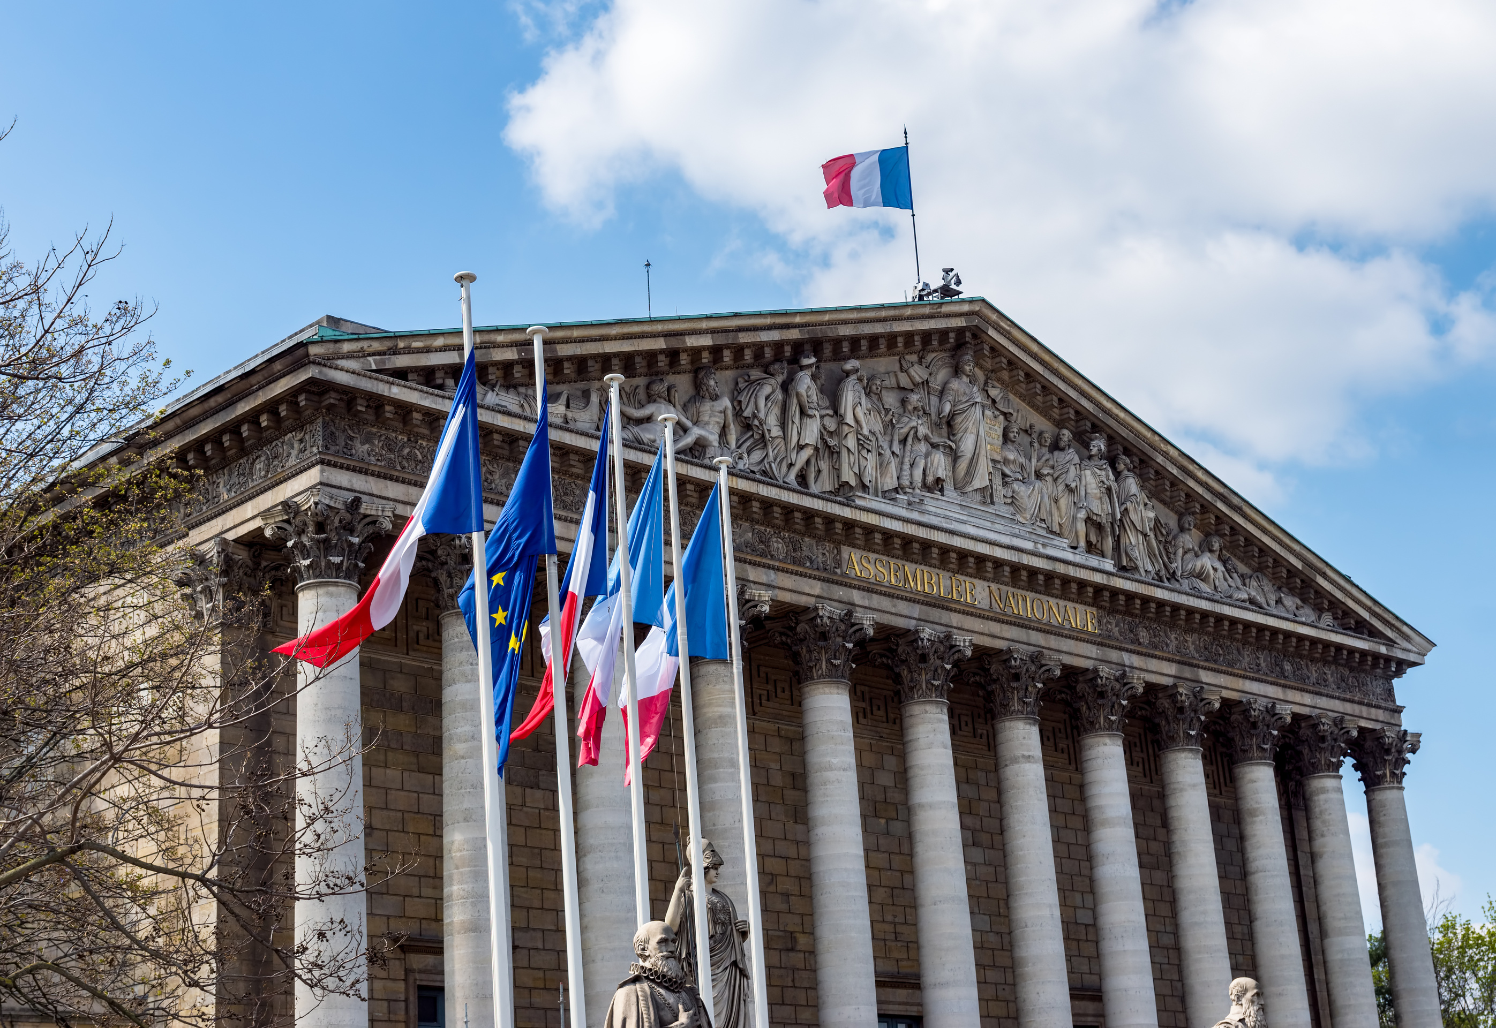

Short political history
1974
René Dumont, the first ecological candidate in the presidential elections, received 1.32% of the votes. The Ecological Movement is born.
1994
Les Verts decided to position themselves on the left and form electoral alliances with the ruling Socialist Party.
2002
The statement "Our house is burning and we are looking elsewhere" was made by Chirac. Ecology has emerged as a theoretical concept embraced by both the right and the left.
2018
The first global climate strike organized by high school students takes place worldwide.

Slide 3






The legal emergence of environmental law in France.
Charte de l’Environnement de 2005
Loi Barnier de 1995
General principles of environmental law
Measures for the prevention of natural risks
Incorporation of Environmental Law into the Constitution
B
D
A
C
Loi sur la protection de la nature de 1976
L'ordonnance n° 2000-914 du 18 septembre 2000
Adoption of the Current Environmental Code

Slide 4
The principles of the Code
Article L110-1
Preventive and corrective action.
Precaution
Polluter-pays principle
Participation

Slide 5

To what extent has the use of environmental law by the Court of Cassation reflected the emergence of ecological consciousness in France?

Slide 6





Scraping Data Collection
DataFrame Creation
Data Analysis
and Visualization

Slide 7
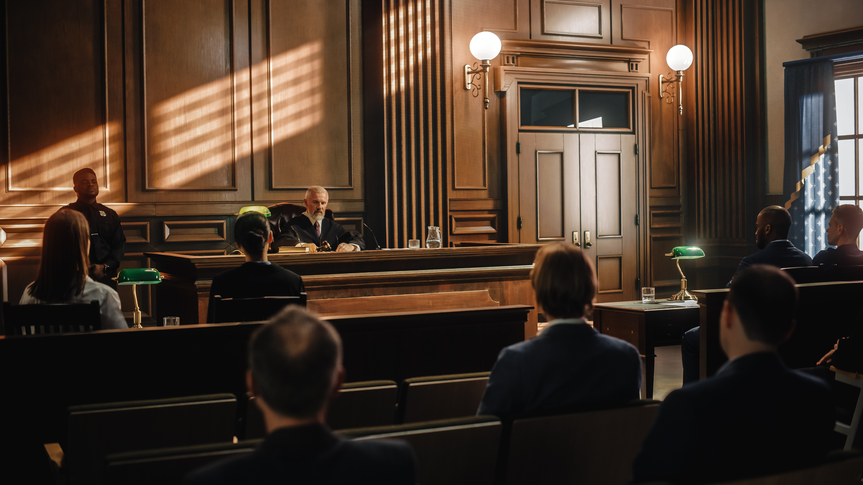




base_url = "https://sandbox-api.piste.gouv.fr/cassation/judilibre/v1.0/search"
params = {
'query': 'code de l\'environnement',
'operator': 'exact',
'date_start': '2000-01-01',
'date_end': '2023-11-21',
'page_size': 30,
'page': 0
}
all_results = []
page_number = 0
while True:
response = client.get(base_url, params=params)
if response.status_code == 200:
results = response.json()
all_results.append(pd.DataFrame(results["results"]))
if not results["next_page"]:
break
params['page'] += 1
else:
print("Error with request")
break
df = pd.concat(all_results)
print( f"{len(df)} résultats.")
Scraping Data Collection to extract court decisions
API Judilibre
From January 1st, 2000, to November 2023
Containing the phrase "Code de l'environnement”

Slide 8
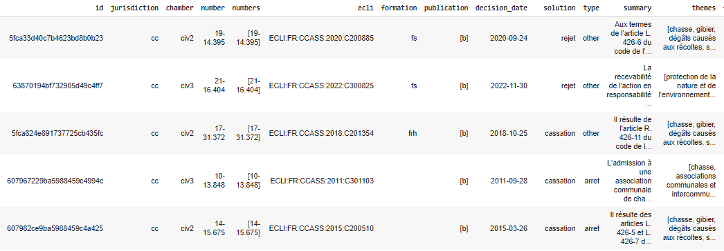
Our dataframe

Slide 9
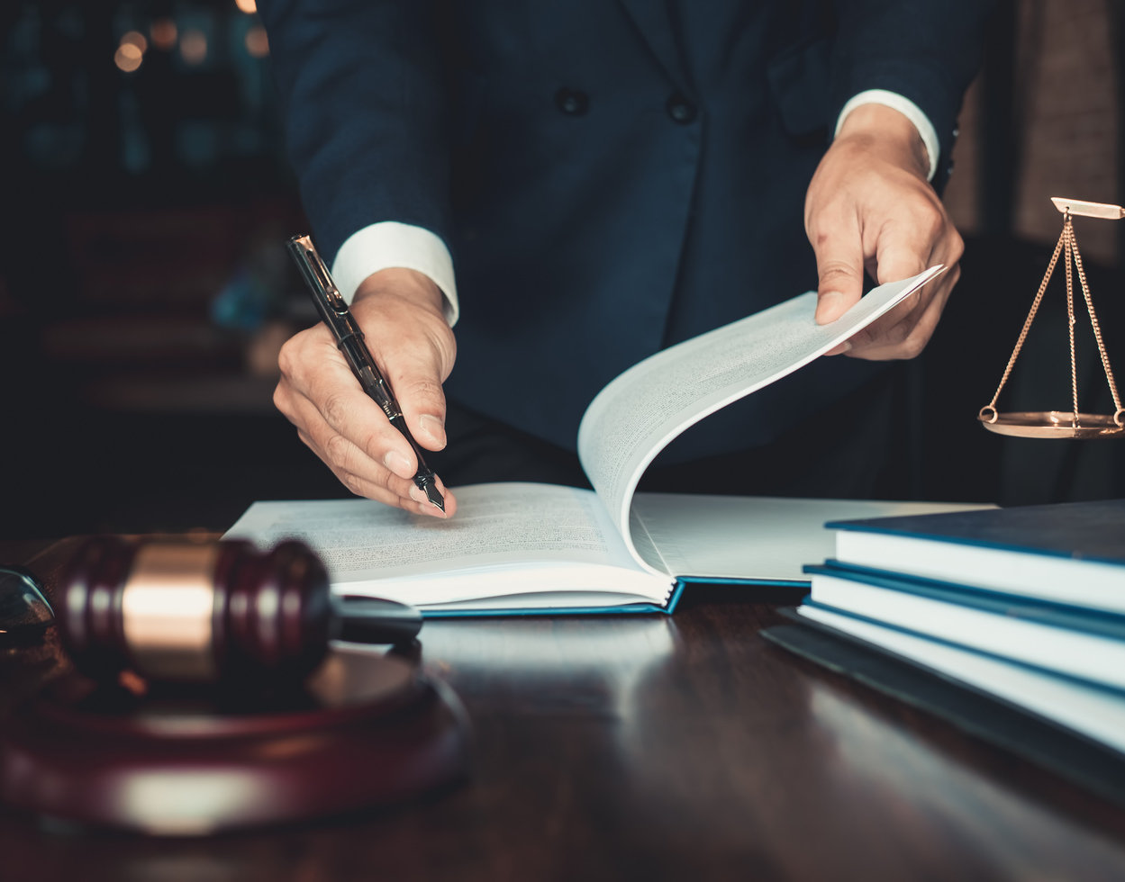
Data Analysis and Visualization
Civil Chamber 1 (Civ1): Broad competence, dealing with disputes related to personal law, family law, matrimonial property law, obligations law.
Civil Chamber 2 (Civ2): Deals with insurance, tort liability, and invasion of privacy.
Civil Chamber 3 (Civ3): Handles disputes in construction law, environmental law, urban planning law, and lease law.
Criminal Chamber: Competent to hear appeals against punitive jurisdictions.
Social Chamber: Competent in labor law and social security matters.
Commercial Chamber: Competent in business law matters.
Cases related to environmental law over time and the chambers overseeing them.

Slide 10

Data Analysis and Visualization
Cases related to environmental law over time and the chambers overseeing them.
df['decision_date'] = pd.to_datetime(df['decision_date'])
df['year'] = df['decision_date'].dt.year

Slide 11
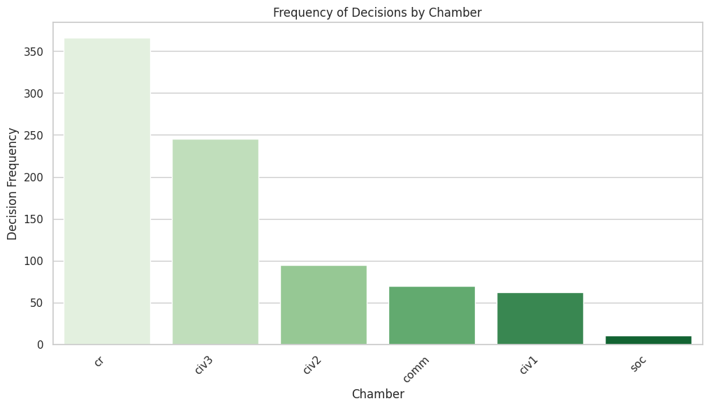

Slide 12
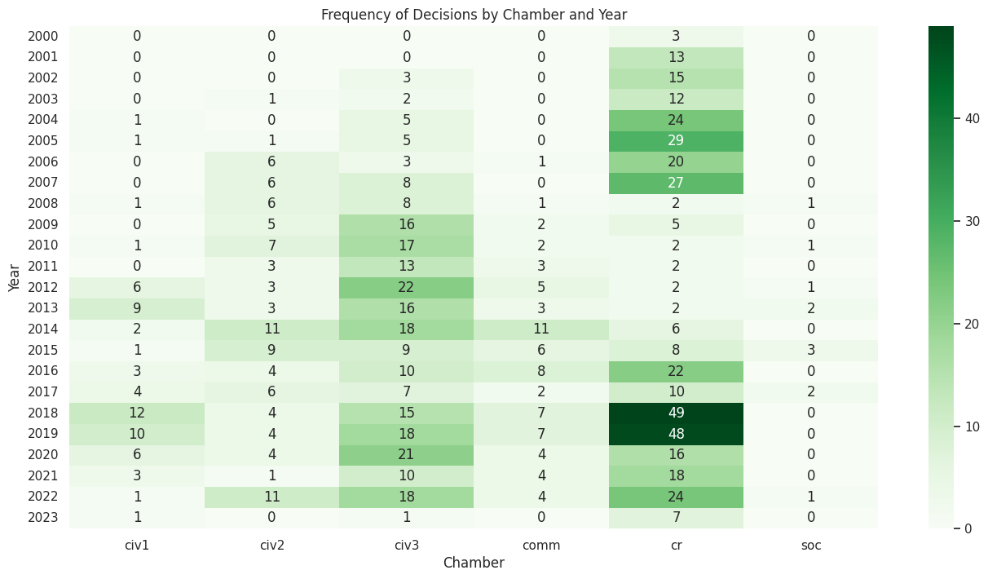
Law on Environmental Responsibility

Slide 13
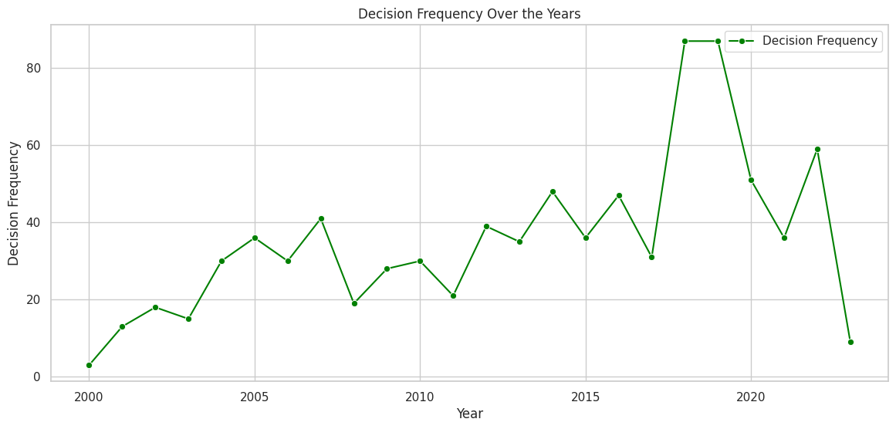

Slide 14
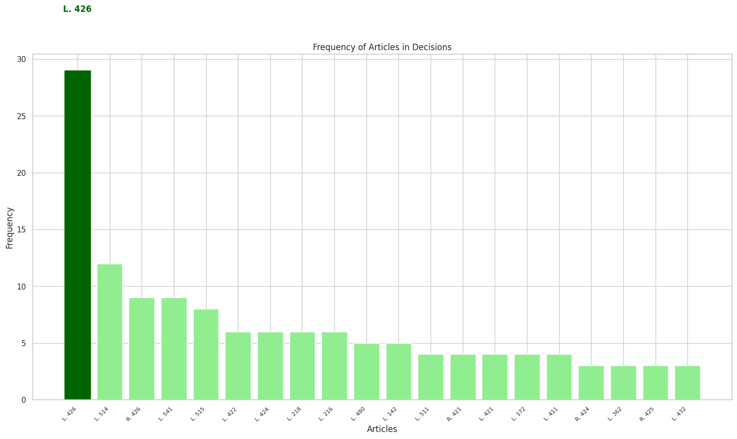
from collections import Counter
df['necolumn'] = df['summary'].apply(lambda x: Counter(re.findall(r'([R|L]. d\d\d-\d)',x)))
print(df['summary'].head(15))
Counter(df['summary'].str.extract(r'([R|L]. [1-7]\d\d-\d)', expand=False))
Most Referenced Article in the Environmental Code
Chapitre VI du Code de l’Environnement: Indemnisation des dégâts de gibiers (Articles L426-1 à L426-8)

Slide 15
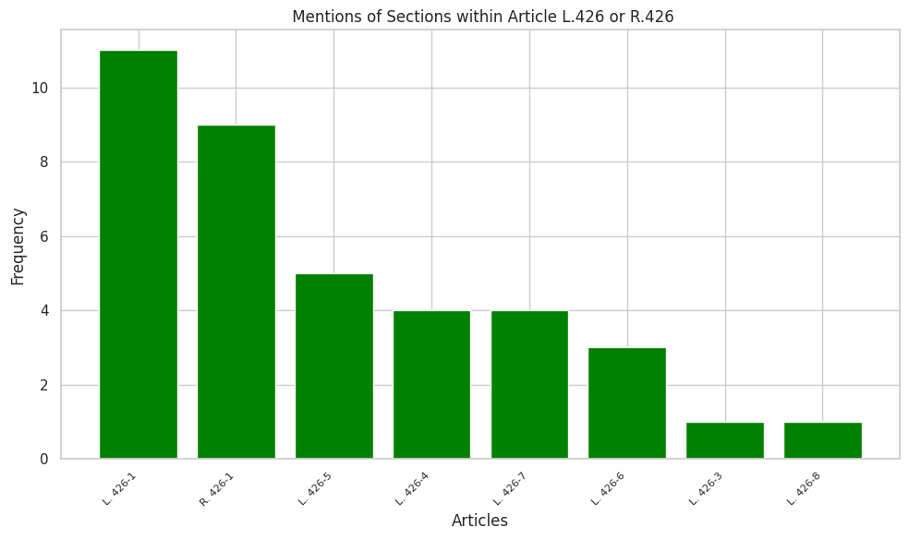

Most Referenced Section of the article 426

Slide 16


Article L426-1 - Modifié par LOI n°2012-325 du 7 mars 2012 - art. 12
“In case of damage caused to crops, inter-row areas of perennial crops, agricultural harvest nets, or agricultural crops either by wild boars or other game species subject to a hunting plan, the operator who has suffered damage requiring restoration, replacement of harvest nets, or resulting in a loss of harvest may claim compensation based on departmental scales from the departmental or interdepartmental federation of hunters”.
Article L426-5 - Modifié par LOI n°2019-773 du 24 juillet 2019 - art. 21
The article outlines the compensation and prevention mechanisms for damages caused by large game species in hunting areas, specifying the role of departmental hunters' federations and the contribution responsibilities of hunters. It also establishes national oversight to ensure fair compensation practices and the representation of various stakeholders in commission compositions.

Slide 17
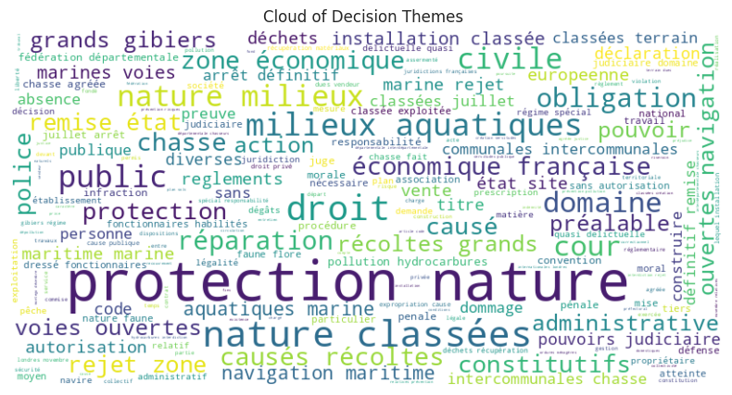
Primary Themes in the Court Decision: “pip install wordcloud”
stop_words = set(stopwords.words('french'))
filtered_words = [word.lower() for word in words if word.isalpha() and len(word) >= 4 and word.lower() not in stop_words]

Slide 18
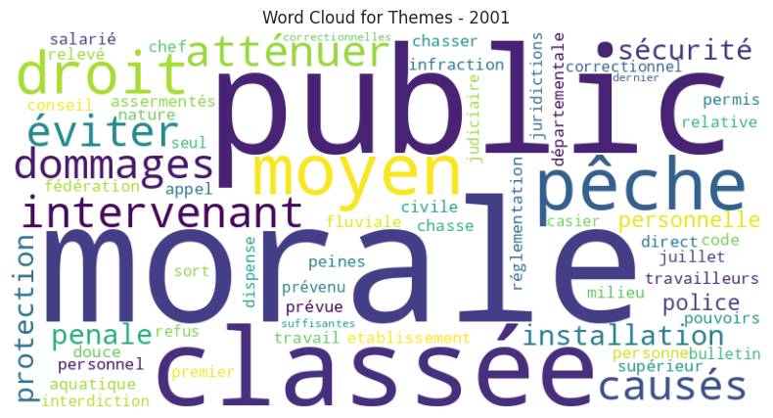
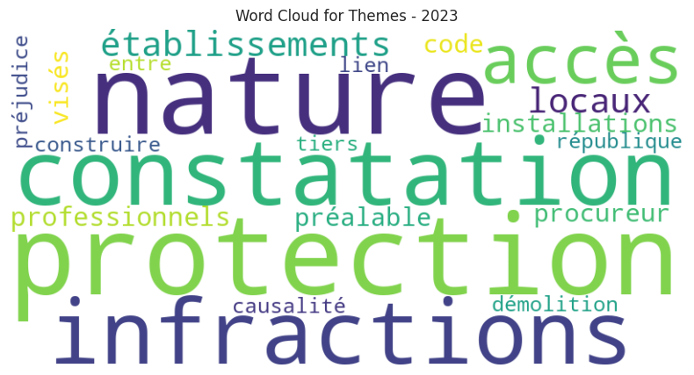
Primary Themes in the Court Decision
2001
2023

Slide 19
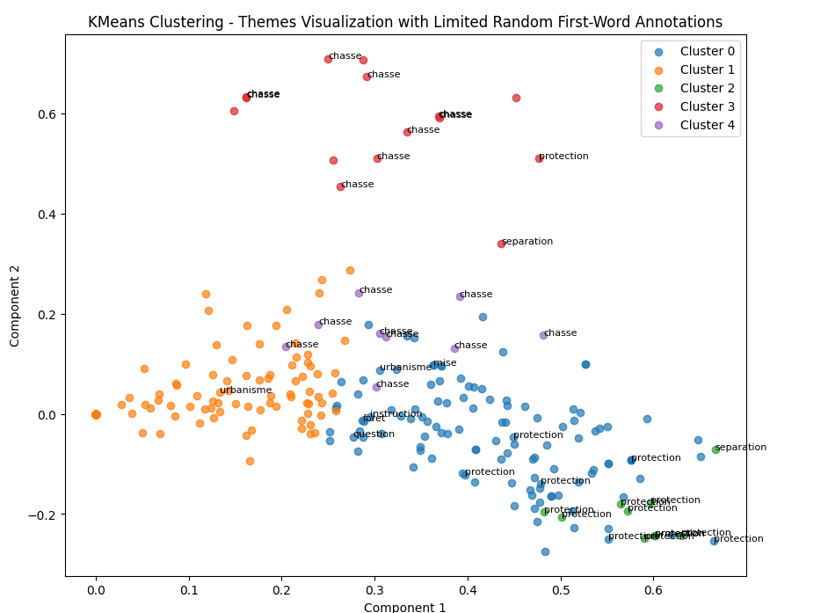

Slide 20
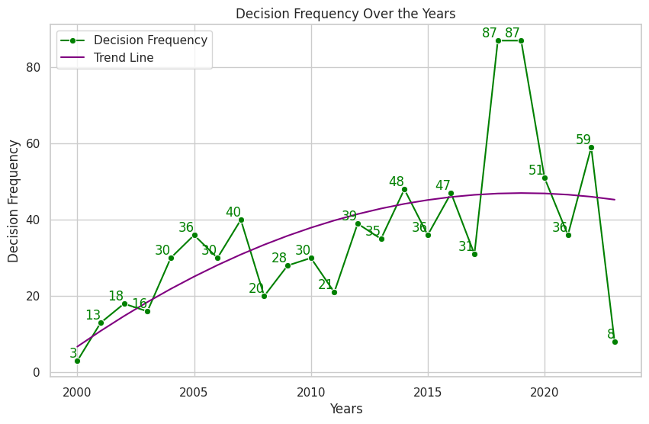

The increase in awareness of environmental issues
We utilized the percentages of representation held by ecological parties in Europe as an indicator of "environmental awareness."

Slide 21
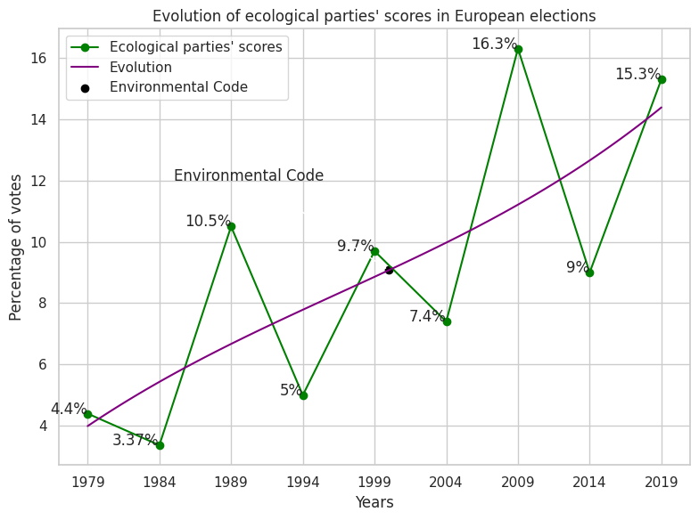
The increase in awareness of environmental issues
We utilized the percentages of representation held by ecological parties in Europe as an indicator of "environmental awareness."

Slide 22


Results
Article 426, focusing on damage from wild boars and hunting, highlights how common environmental issues relate to daily life. The environmental code extends beyond climate warming concerns.
Percentages of representation by ecological parties correlate with increased legal judgments, reinforcing the link between legal actions and rising public awareness of environmental issues.
The Criminal Chamber is key in environmental legal matters. The resurgence of this chamber since 2016 aligns with a potential shift driven by growing ecological awareness.

Slide 23

Thank You!
LEGAL DATA ANALYSIS
2023/2024

